Slide 1
A Photo Journey of the South African Youth Day

Slide 2
June 16, 1976

Slide 3
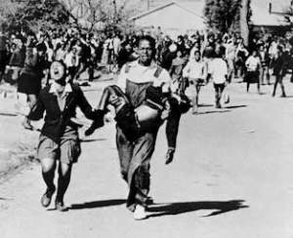
Soweto Uprising

Slide 4
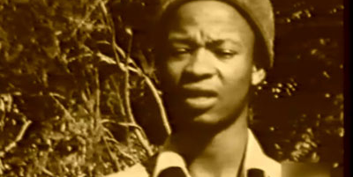
SSRC

Slide 5
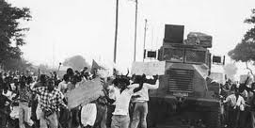
Apartheid Police

Slide 6
June 16, 2013

Slide 7
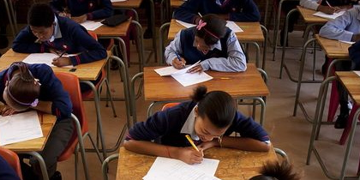
Basic Education

Slide 8
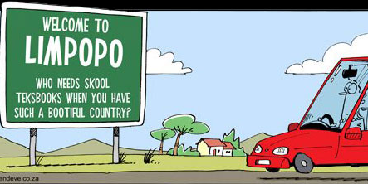
Service Delivery

Slide 9
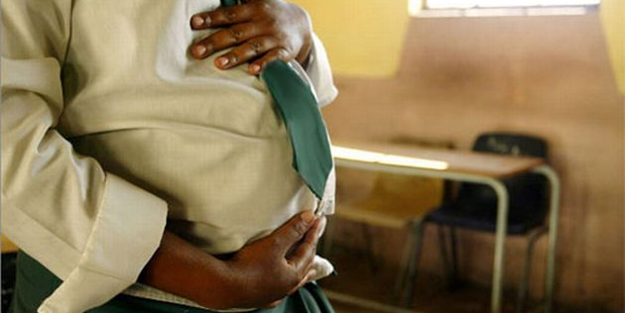
Teenage Pregnancy

Slide 10
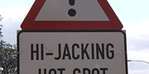
Crime

Slide 11
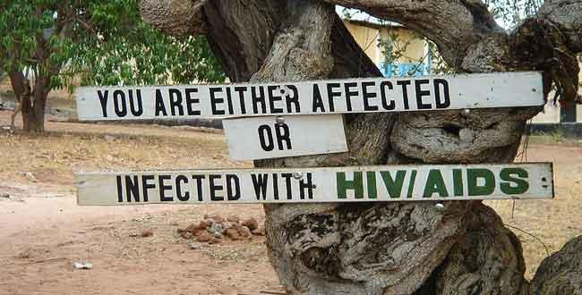
Diseases

Slide 12
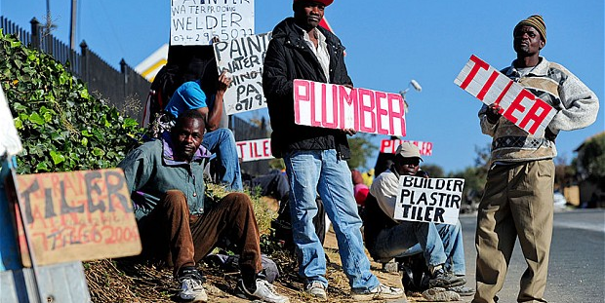
Youth Unemployment

Slide 13
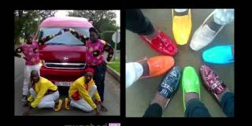
Skhothane

Slide 14
Skhothane Prayer
OUR KURT GEIGER WHO ART IN SPITZ,
HALLOWED BE THY CAVERLLA,
THY LACOSTE COME,
THY WILL BE WORN IN TOWNSHIPS,
AS IT IS IN SANDTON,
GIVE US VERSAGE OUR DAILY WEAR
& FORGIVE US FOR BUYING PRO-ACTIONS,
AS WE FORGIVE THOSE WHO BUY NO-NAME,
LEAD US NOT INTO BUYING FONG-KONGS,
BUT DELIVER US FROM PEP,
FOR THY IS THE LEVI’S, THE DIESEL AND THE NIKE
FOR EVER AND EVER BLACKLISTED.
AMEN!

Slide 15
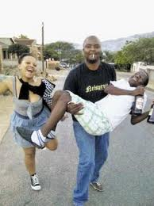
Alcohol and Drug Abuse

Slide 16
“What do we do now?”

Slide 17
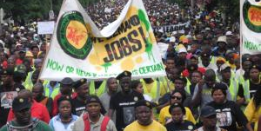
Economic Freedom

Slide 18
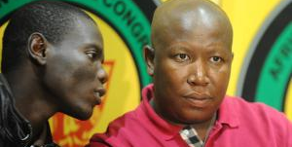
Nationalisation

Slide 19
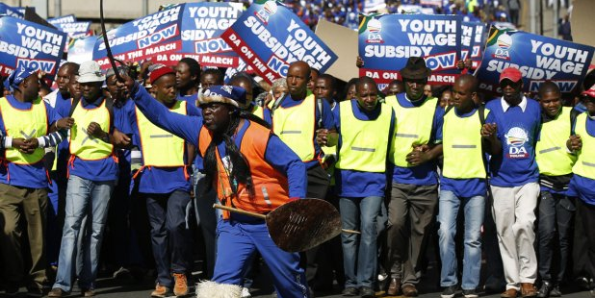
Youth Wage Subsidy

Slide 20

Literacy

Slide 21
Appendix
Maya the Poet
Opinion: FNB Ad

